Slide 1
Fine-Grained DRAM: Energy Efficient DRAM for Extreme Bandwidth Systems
Mike O’Connor
Niladrish Chatterjee
Donghyuk Lee
John Wilson
Aditya Agrawal
Stephen W. Keckler
William J. Dally

Slide 2
Future GPUs need more DRAM bandwidth
Demand is accelerating
GPU nodes in Exascale supercomputers will require 4 TB/s of bandwidth*
GPUs approaching 1 TB/s today
Emerging Deep-Learning applications coupled with domain specific accelerator units (e.g. Volta Tensor Cores) accelerating demand for additional bandwidth
* O. Villa, D.R. Johnson, M. O’Connor, E. Bolotin, D. Nellans, J. Luitjens, N. Sakharnykh, P. Wang, P. Micikevicius, A. Scudiero, S.W. Keckler, and W.J. Dally, “Scaling the Power Wall: A Path to Exascale,” Supercomputing 2014.

Slide 3
Why Do GPUs Demand so Much DRAM Bandwidth?
Lots of compute:
84 Streaming Multiprocessors each w/ 64 execution units
Lots of threads
64 warps of 32 threads per SM 172,032 threads executing on 5,376 execution units
Not a lot of caching/on-chip state:
→ 7134 bytes/warp of on-chip memory (vs. 877,849 bytes/HW thread on 28-core Xeon)
NVIDIA Volta GV100

Slide 4
Require 4x Increase in Bandwidth
While still remaining cost-effective
Two factors:
Increase I/O bandwidth
More I/Os
Faster I/Os
Increase bandwidth of DRAM storage arrays
More DRAM devices
Higher-bandwidth DRAM devices

Slide 5
More DRAM devices
Not a realistic approach to 4x more bandwidth
Interposer signaling limited to short (few mm) wires
Can’t easily fit significantly more devices in package

Slide 6
Increasing DRAM Array Bandwidth
Four approaches
Cycle a single bank faster (reduce tCCD_{L})
Get more bits per access to a bank (increase atom size)
Overlap accesses to more banks (reduce tCCD_{S})
Access more banks in parallel (more channels)

Slide 7
Increasing DRAM Array Bandwidth
Four approaches
Cycle a single bank faster (reduce tCCD_{L})
- Not possible (w/o significant additional DRAM area)
Get more bits per access to a bank (increase atom size)
Overlap accesses to more banks (reduce tCCD_{S})
Access more banks in parallel (more channels)

Slide 8
Increasing DRAM Array Bandwidth
Four approaches
Cycle a single bank faster (reduce tCCD_{L})
- Not possible (w/o significant additional DRAM area)
Get more bits per access to a bank (increase atom size)
- Bad for perf (17% on GFX w/ 128B atom) – increases row size/activation energy
Overlap accesses to more banks (reduce tCCD_{S})
Access more banks in parallel (more channels)

Slide 9
Increasing DRAM Array Bandwidth
Four approaches
Cycle a single bank faster (reduce tCCD_{L})
- Not possible (w/o significant additional DRAM area)
Get more bits per access to a bank (increase atom size)
- Bad for perf (17% on GFX w/ 128B atom) – increases row size/activation energy
Overlap accesses to more banks (reduce tCCD_{S})
Access more banks in parallel (more channels)
Make Energy/Access Worse

Slide 10
Increasing DRAM Array Bandwidth
Four approaches
Cycle a single bank faster (reduce tCCD_{L})
- Not possible (w/o significant additional DRAM area)
Get more bits per access to a bank (increase atom size)
- Bad for perf (17% on GFX w/ 128B atom) – increases row size/activation energy
Overlap accesses to more banks (reduce tCCD_{S})
- Extreme Bank Grouping (8:1 w/ 4x BW) (11% perf cost)
Access more banks in parallel (more channels)

Slide 11

Increasing DRAM Array Bandwidth
Four approaches
Cycle a single bank faster (reduce tCCD_{L})
- Not possible (w/o significant additional DRAM area)
Get more bits per access to a bank (increase atom size)
- Bad for perf (17% on GFX w/ 128B atom) – increases row size/activation energy
Overlap accesses to more banks (reduce tCCD_{S})
- Extreme Bank Grouping (8:1 w/ 4x BW) (11% perf cost)
Access more banks in parallel (more channels)

Slide 12
Quad-Bandwidth HBM: More parallel channels
Conventional HBM2 Channel Quad-Bandwidth HBM Channels
Bank
Bank
Bank
Bank
Four
16 GB/s
Channels
4x more BW
overall
Shared
16 GB/s
Channel
Bank
Bank
Bank
Bank
16 banks per channel 4 banks per channel Bandwidth of idle banks is “wasted” More banks operating in parallel Same # of I/O running 4x faster

Slide 13
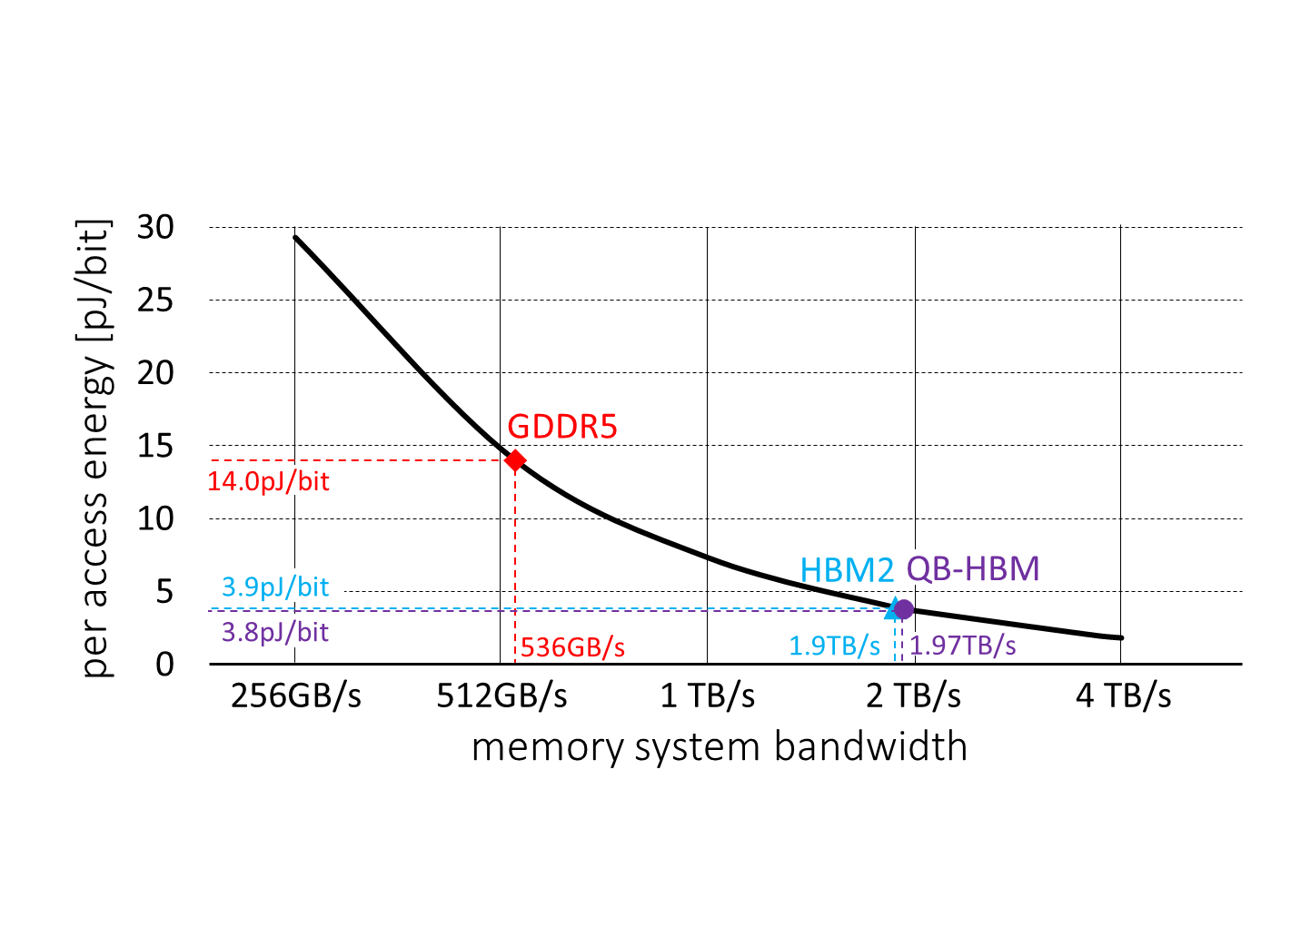
DRAM Energy Critical for Multi-TB/s DRAM
Consuming increasing fraction of fixed power budgets
60W Power Budget
Need ~2pJ/bit DRAM to deliver ≥4 TB/s systems

Slide 14
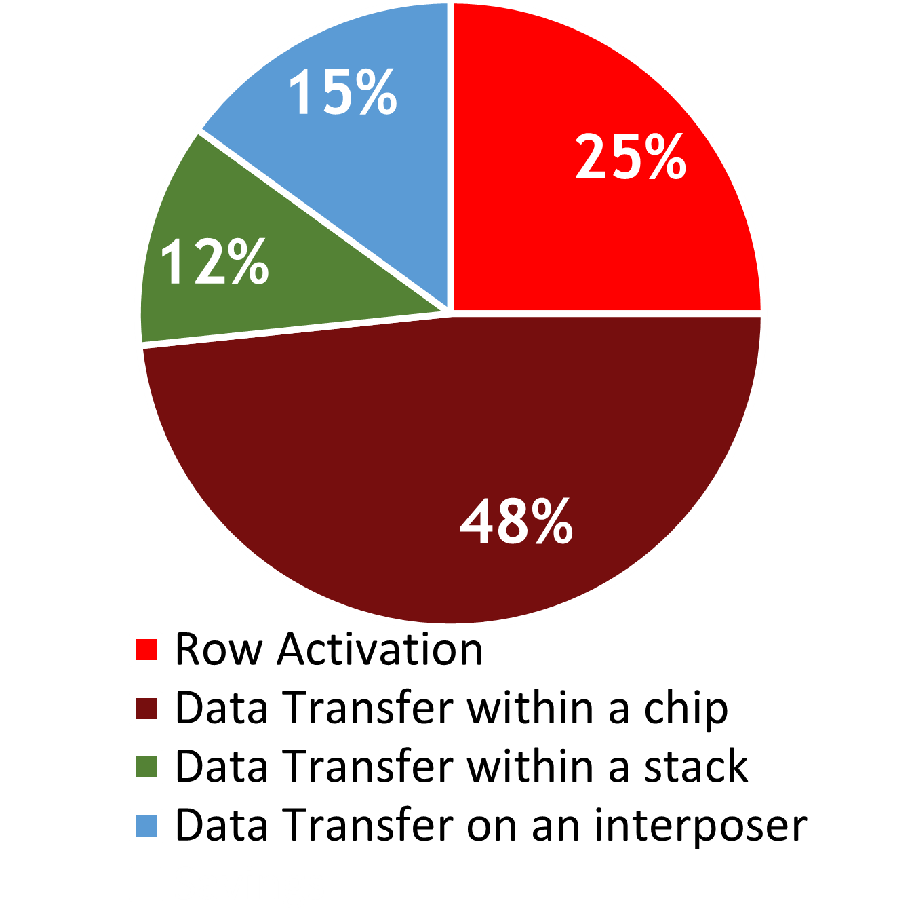
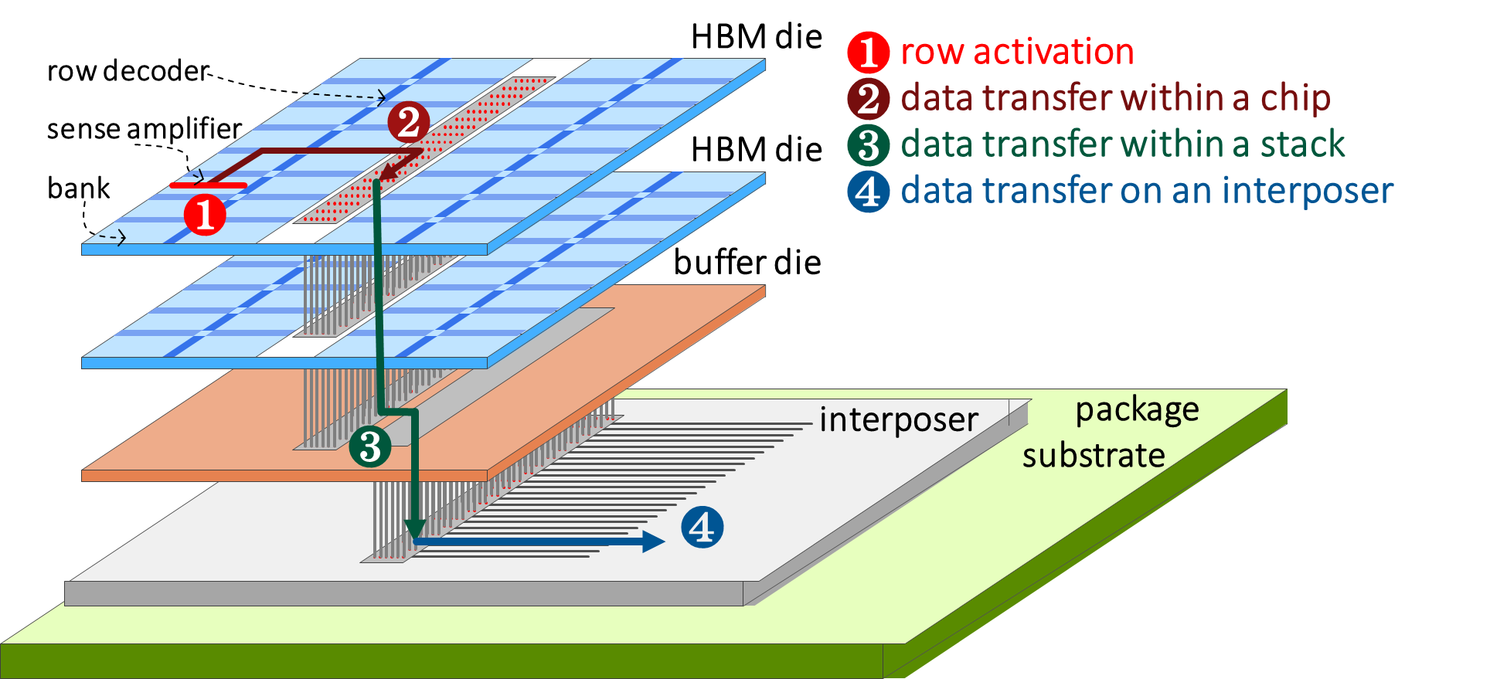
DRAM Energy
In HBM2

Slide 15
Fine-Grained DRAM: Narrow Channels, Local I/O
Quad-Bandwidth HBM Channels Fine-Grained DRAM Arch.
Partition Bank into
Narrower Pseudobanks
Bank
Bank
Bank
Bank
Four
16 GB/s
Channels
32
Dedicated
Local
2 GB/s
Channels
Bank
Bank
Bank
Bank
Shared inter-bank bus Local, parallel I/O per bank High data movement energy Reduced data movement energy High activation energy Reduced activation energy

Slide 16
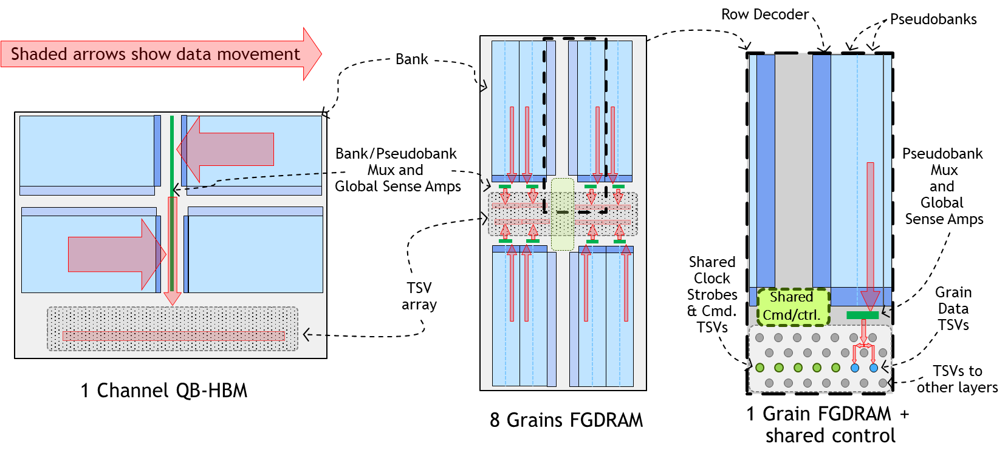
Reducing Data Movement Energy
Limiting distance data travels within a chip

Slide 17
Reducing Activation Energy
Another synergistic benefit of lower-bandwidth channels
DRAM row size is a function of per-bank bandwidth
2 GB/s of bandwidth per grain requires only 4 mats to be active
- Reduces row size by factor of four
- Use master-wordline segmentation technique* to “vertically” slice each bank into 4 narrower 2 GB/s “pseudobanks”
* N. Chatterjee, M. O'Connor, D. Lee, D. R. Johnson, M. Rhu, S.W. Keckler, W. J. Dally,
“Architecting an Energy-Efficient DRAM System for GPUs,”
High Performance Computer Architecture (HPCA 2017), February 2017.

Slide 18
Costs of Lower Bandwidth Channels
Not generally an issue with GPUs
tBURST: 32B DRAM atom requires 16ns to serialize across grain I/Os
HBM2/QB-HBM require only 2ns
14 extra ns small fraction of additional “empty pipe” latency
Most latency is queuing delay in memory intensive workloads
Longer tBURST means fewer row-hits needed for peak bandwidth
Memory Controller: Rate of commands same between QB-HBM and FG-DRAM

Slide 19
Evaluation

Slide 20
Methodology
Energy estimates use a bottom-up physical model of stacked DRAM
Models the switching energies on the wires and drivers
Performance estimations on an in-house GPU simulator
Models a NVIDIA Pascal GPU (P100)
Workloads
Compute benchmarks: HPC Exascale mini-apps, Rodinia, Lonestar, GoogLeNet
Graphics: Games and rendering engines

Slide 21
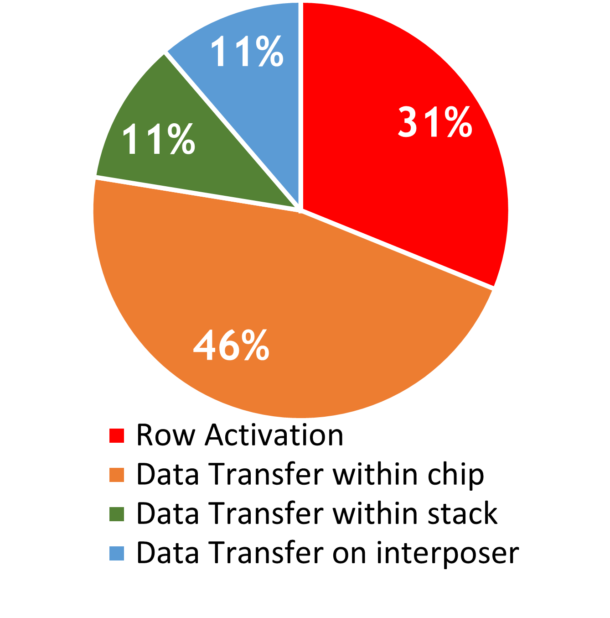
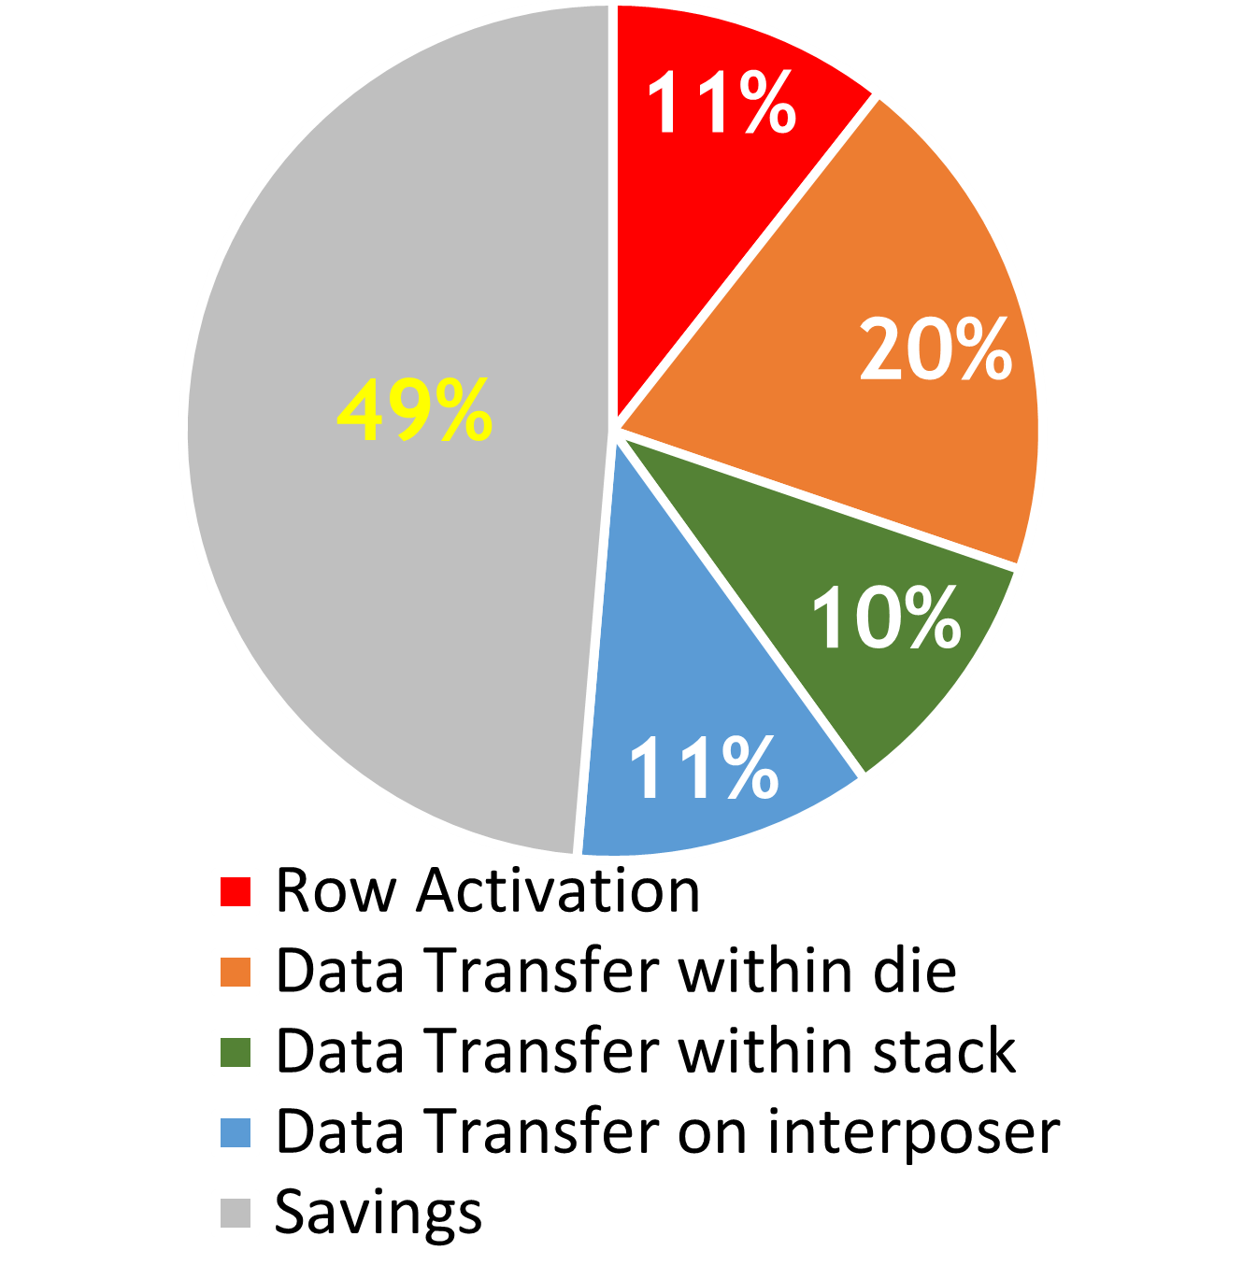
DRAM Energy Consumption
49% savings
QB-HBM (3.8 pJ/bit)
FGDRAM (1.9 pJ/bit)

Slide 22
DRAM Energy Consumption
Energy-per-bit similar across workloads
Memory Intensive Applications

Slide 23
GPU Performance with FGDRAM
19% average improvement
High-locality applications can utilize the entire bandwidth.
Small benefits from increased read-write parallelism.
High Locality
Low memory intensity
Low Locality
Low-locality applications benefit from increased bank-level parallelism and faster row-activate rates.

Slide 24
DRAM Area
Modest area increases
QB-HBM
8.57% larger than HBM2
FG-DRAM
1.65% larger than QB-HBM
HBM2
More global sense amps and routing for extra BW
Global sense amps plus
area for pseudobanking

Slide 25
Conclusion
Fine-Grained DRAM
FG-DRAM can achieve a 4x increase in bandwidth with a 2x reduction in energy-per-bit transferred versus HBM2 DRAM
Enables multi-TB/s DRAM systems within practical energy budgets
Fine-Grained DRAM is an energy-efficient parallel
DRAM architecture well suited to massively-threaded, high-bandwidth, parallel processors like GPUs
Notes:
2 clicks –
Not there yet even will all the attacks on row energy
Need more savings to hit target.
But how?

Slide 27
Backup

Slide 28
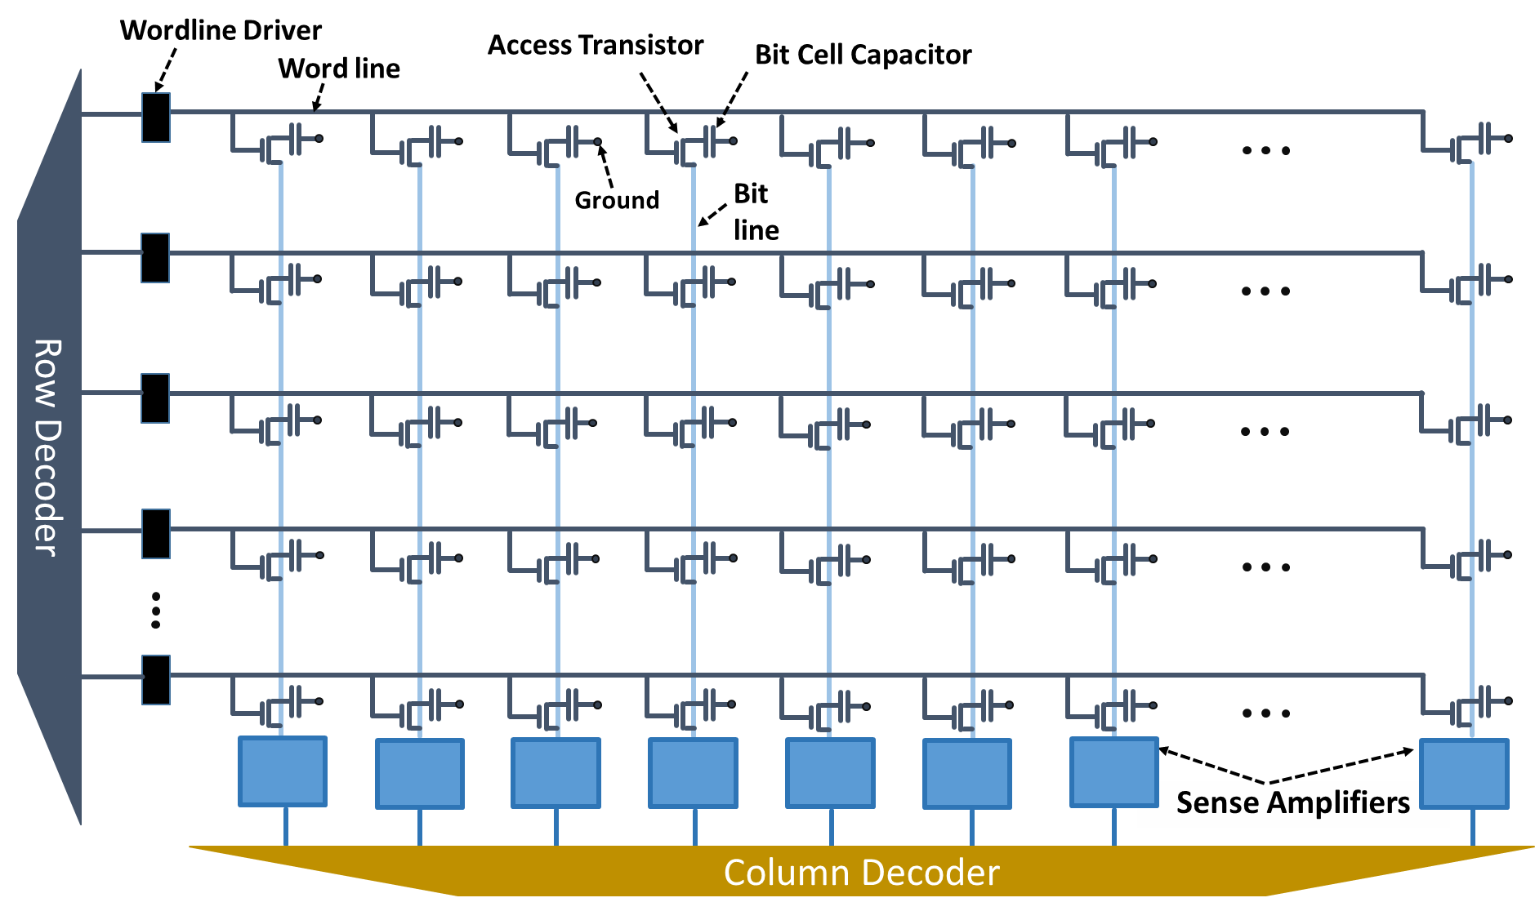
DRAM Basics
Basic Building Block: Array of bit cells
Data stored as charge on a capacitor
Bit-line is precharged to V/2
Wordline activates access transistor
Charge on capacitor deflects bit line voltage towards 0 or V
Sense amplifier drives bit line to 0 or V, restoring value in bit cell cap.
Subset of activated data is read from sense amps via column mux
Capacitors leak, requiring periodic refresh

Slide 29
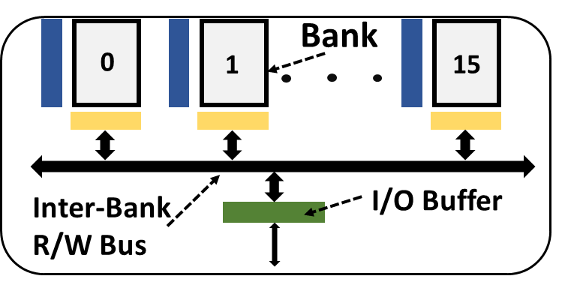
DRAM Basics
Multiple Arrays On Shared Bus
There are limits to the size of a single DRAM array
As larger devices evolved, arrays were broken up into independent banks
Also, overlap precharge/activation delays in one bank with access to another
Notes:
As we got to the 1 Mbit generation of DRAMs (late 80s) couldn’t make bitline longer. Would need larger capacitor to deflect bitline capacitance a reasonable amount.
Moved to multi-bank designs…

Slide 30
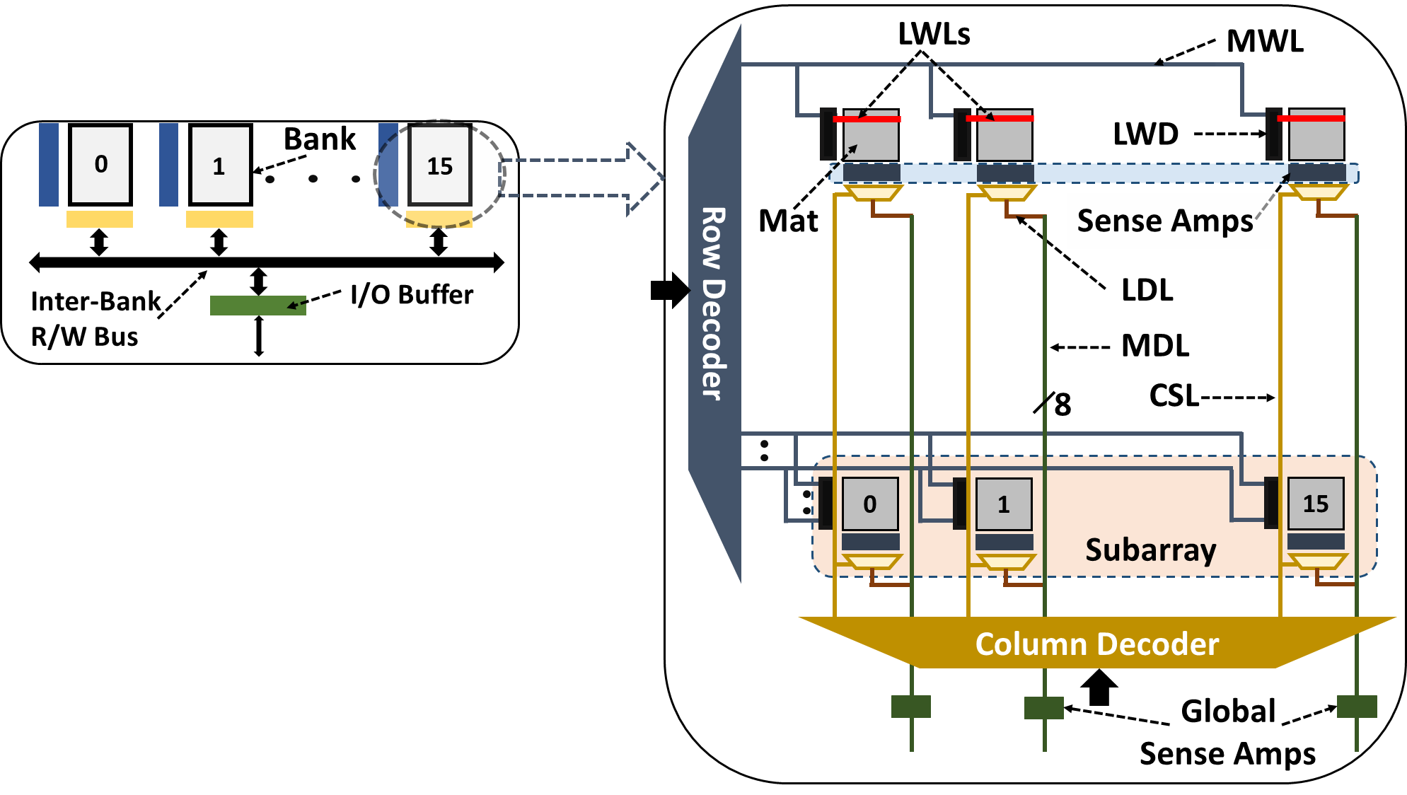
DRAM Basics
Internal Structure of Banks
In practice, a single bank is composed of many smaller arrays.
Each 512x512 (roughly) array of DRAM cells is a mat
They are grouped together to form a 16384 row x 8192 bit bank
Column mux selects 8-bits per mat to read out on each access
Notes:
Fast forward to now, and a single bank is actually pretty complex. The basic array (a mat) is O(256 Kbits) like forever ago.
A bank is an array of mats tightly packed together. Size of a bank is limited by capacitance of Master wordlines and master data lines. Plus more bankc is generally better for perf.
(and really wide banks is bad for row size activation overfetch).
Talk about layout optimizations (and/or make a picture)

Slide 31
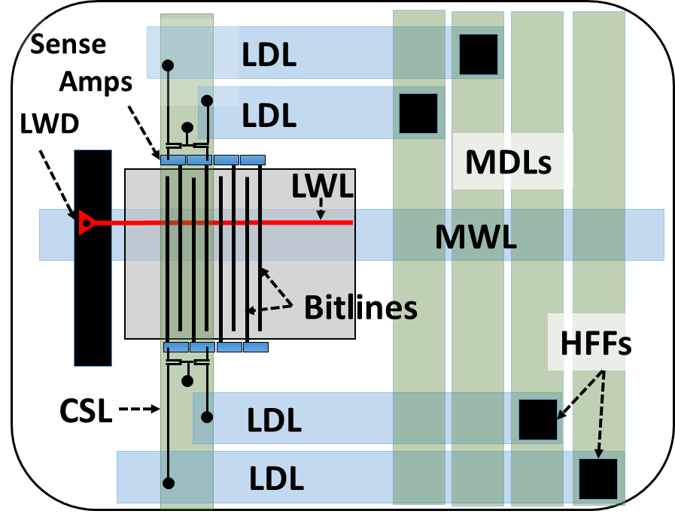
DRAM Basics
Highly Optimized Layout
The layout of each mat is heavily optimized for density
Only 3 layers of metal + one poly
Upper layers of metal roughly 4x pitch
Cell array tightly packed at min. pitch
Some structures like sense-amps and wordline drivers are larger (and shared between adjacent mats)
These details allow area costs of different alternatives to be modeled
Notes:
Fast forward to now, and a single bank is actually pretty complex. The basic array (a mat) is O(256 Kbits) like forever ago.
A bank is an array of mats tightly packed together. Size of a bank is limited by capacitance of Master wordlines and master data lines. Plus more bankc is generally better for perf.
(and really wide banks is bad for row size activation overfetch).
Talk about layout optimizations (and/or make a picture)

Slide 32
Overlapping Requests to Different Banks
Bank Grouping

Slide 33
Reducing Row Size
Pseudobanks: Area-efficient 256B row activations

